Slide 1






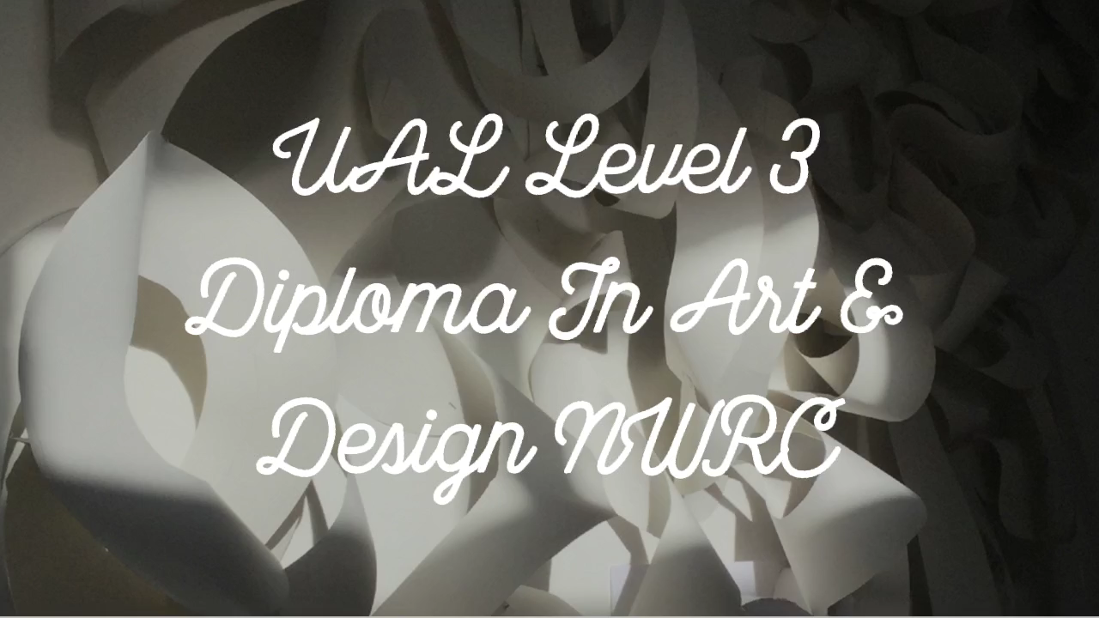






Art and Design
UAL Level 3 Diploma / Extended Diploma
Click below image to see
samples of work and units
of study for year1
www.nwrc.ac.uk

Slide 2


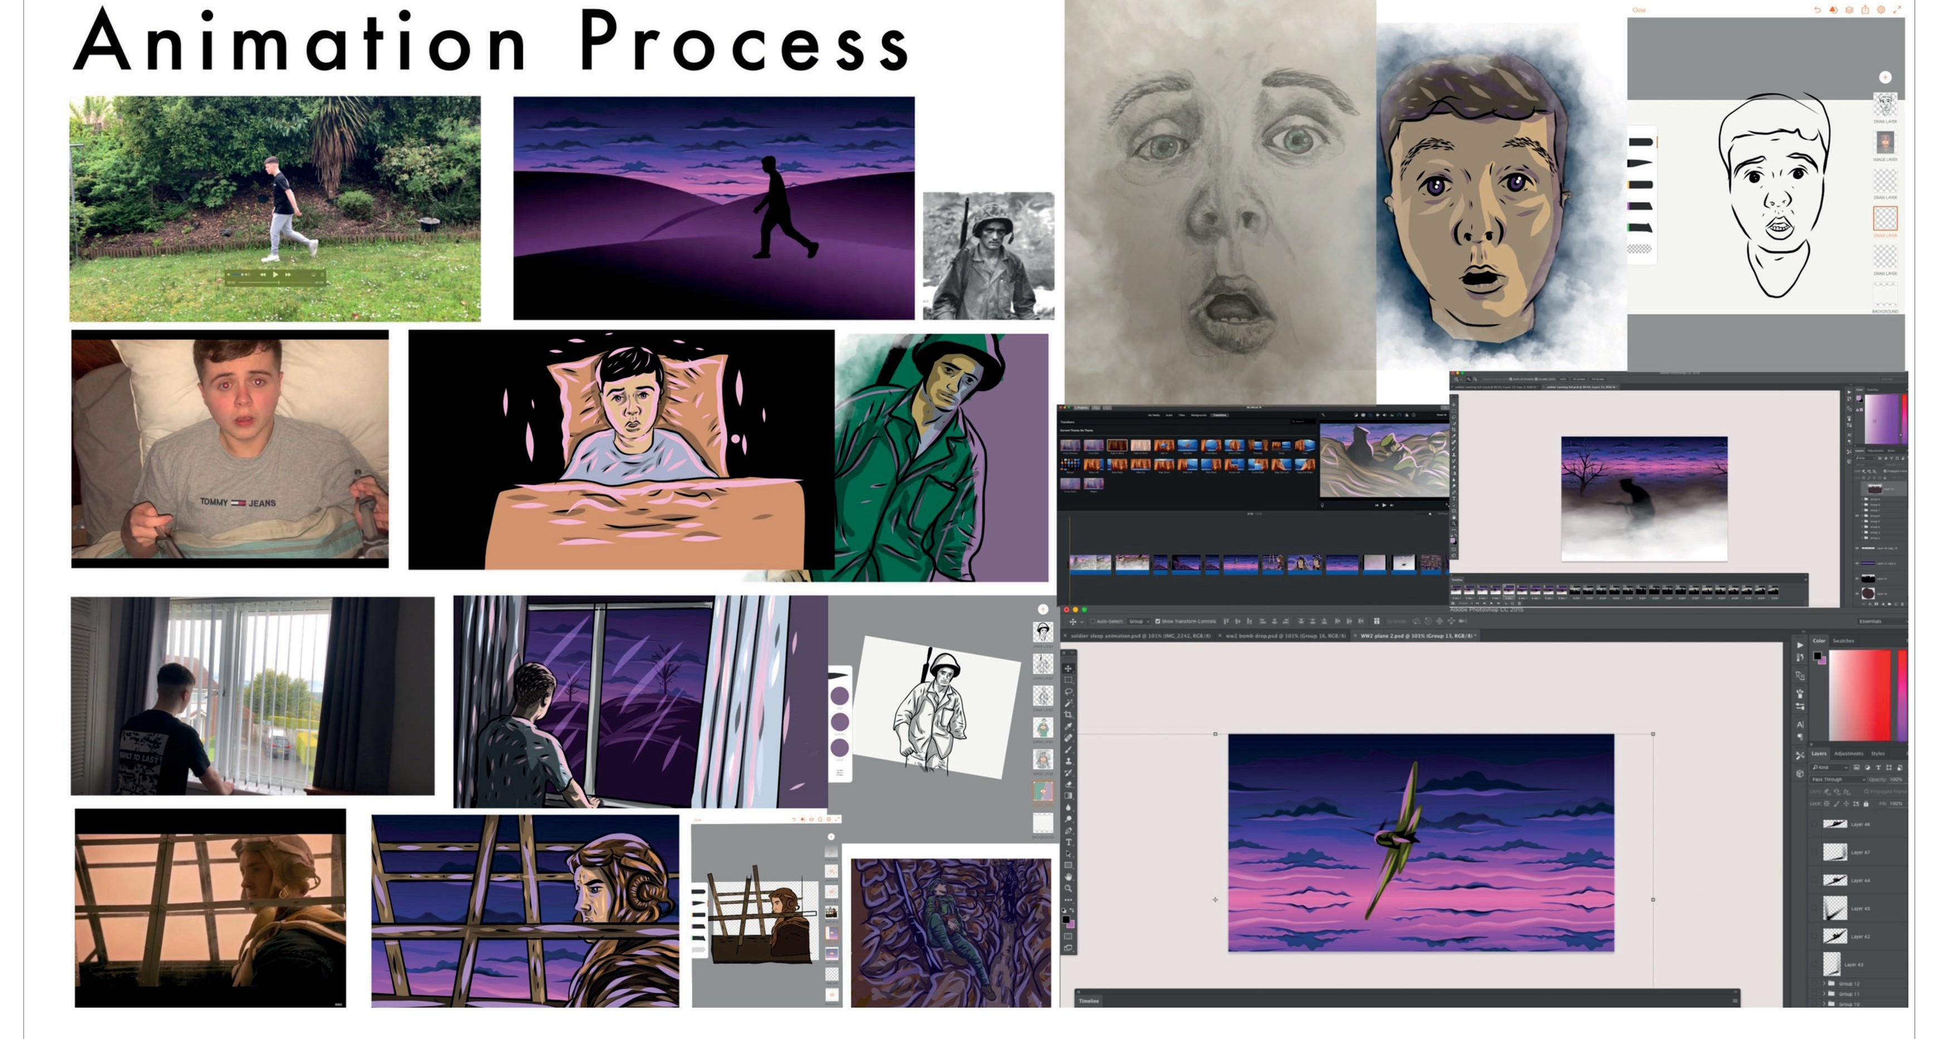
Art and Design
UAL Level 3 Diploma / Extended Diploma
www.nwrc.ac.uk

Slide 3






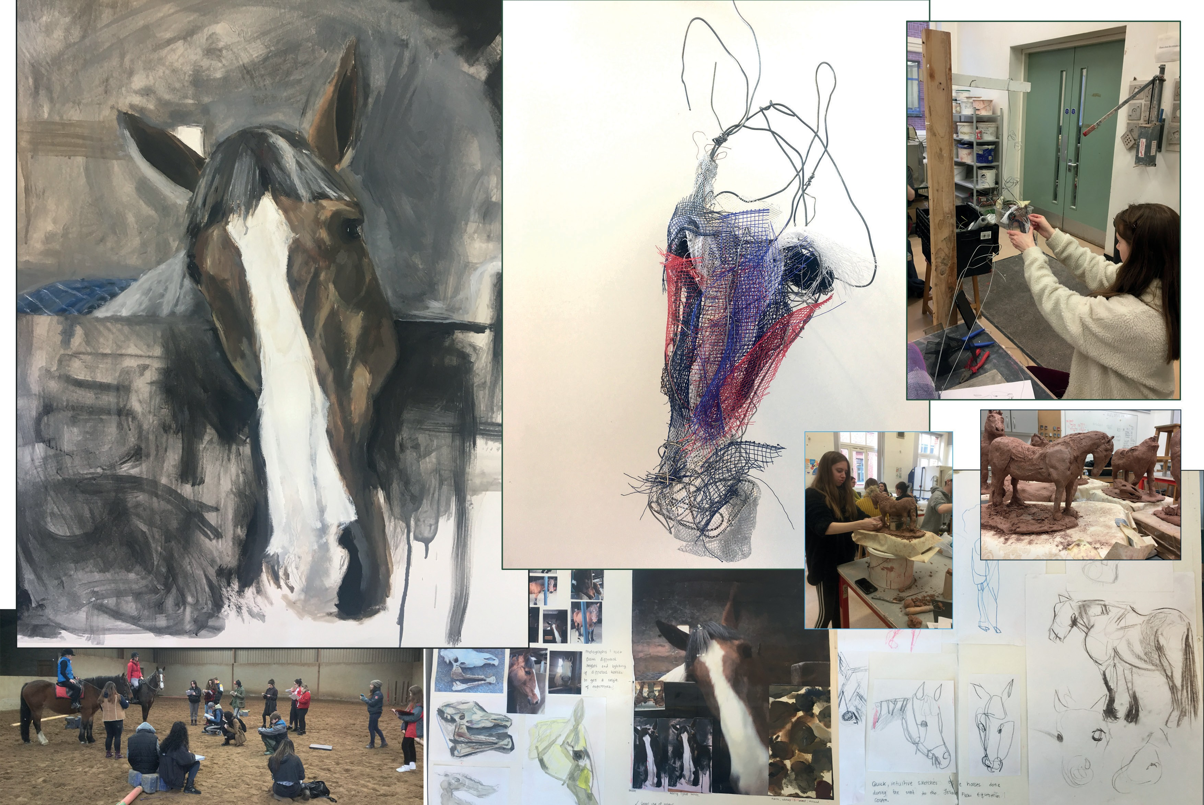





Art and Design
UAL Level 3 Diploma / Extended Diploma
www.nwrc.ac.uk

Slide 4
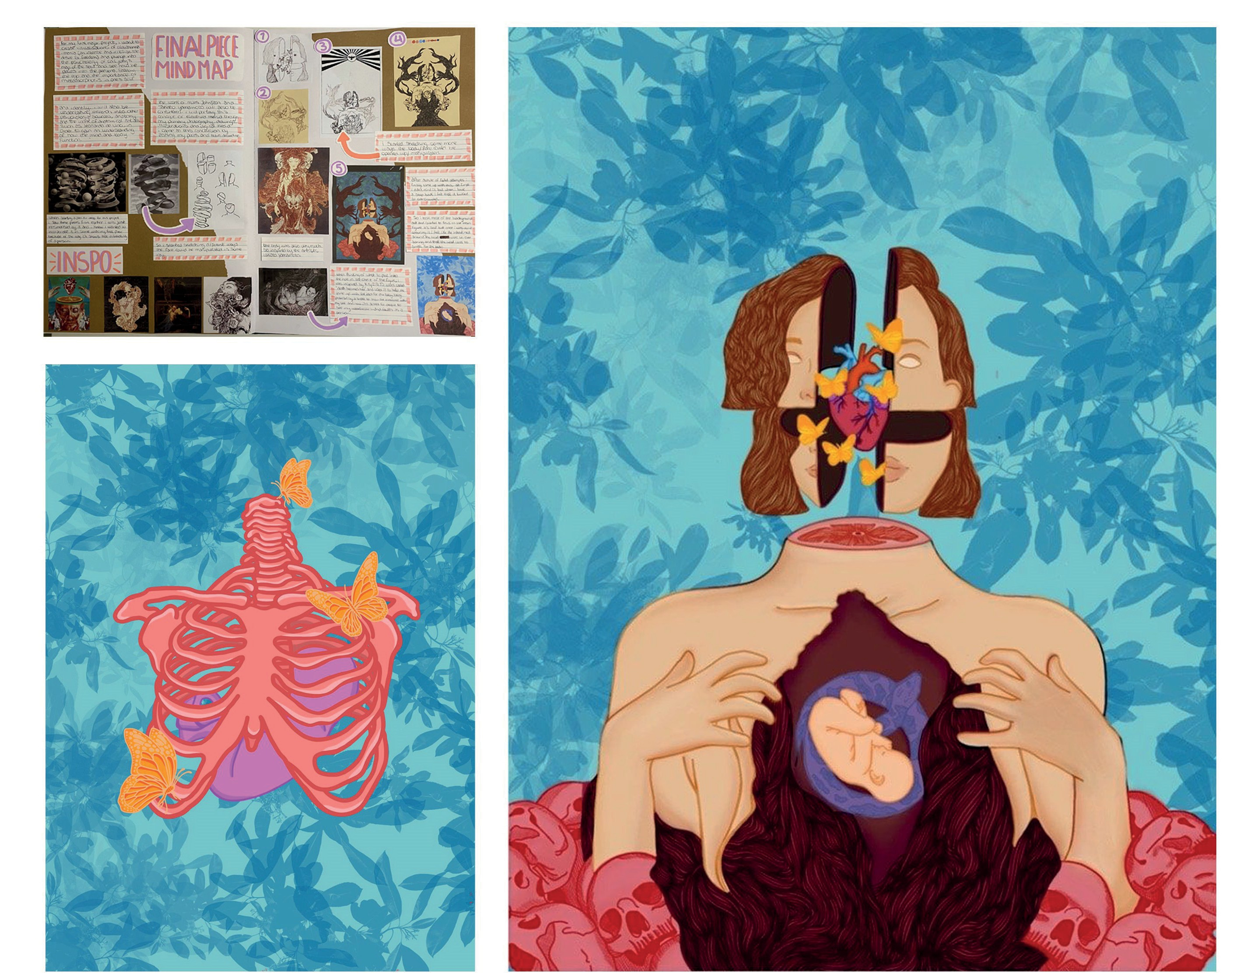
Art and Design
UAL Level 3 Diploma / Extended Diploma
www.nwrc.ac.uk

Slide 5



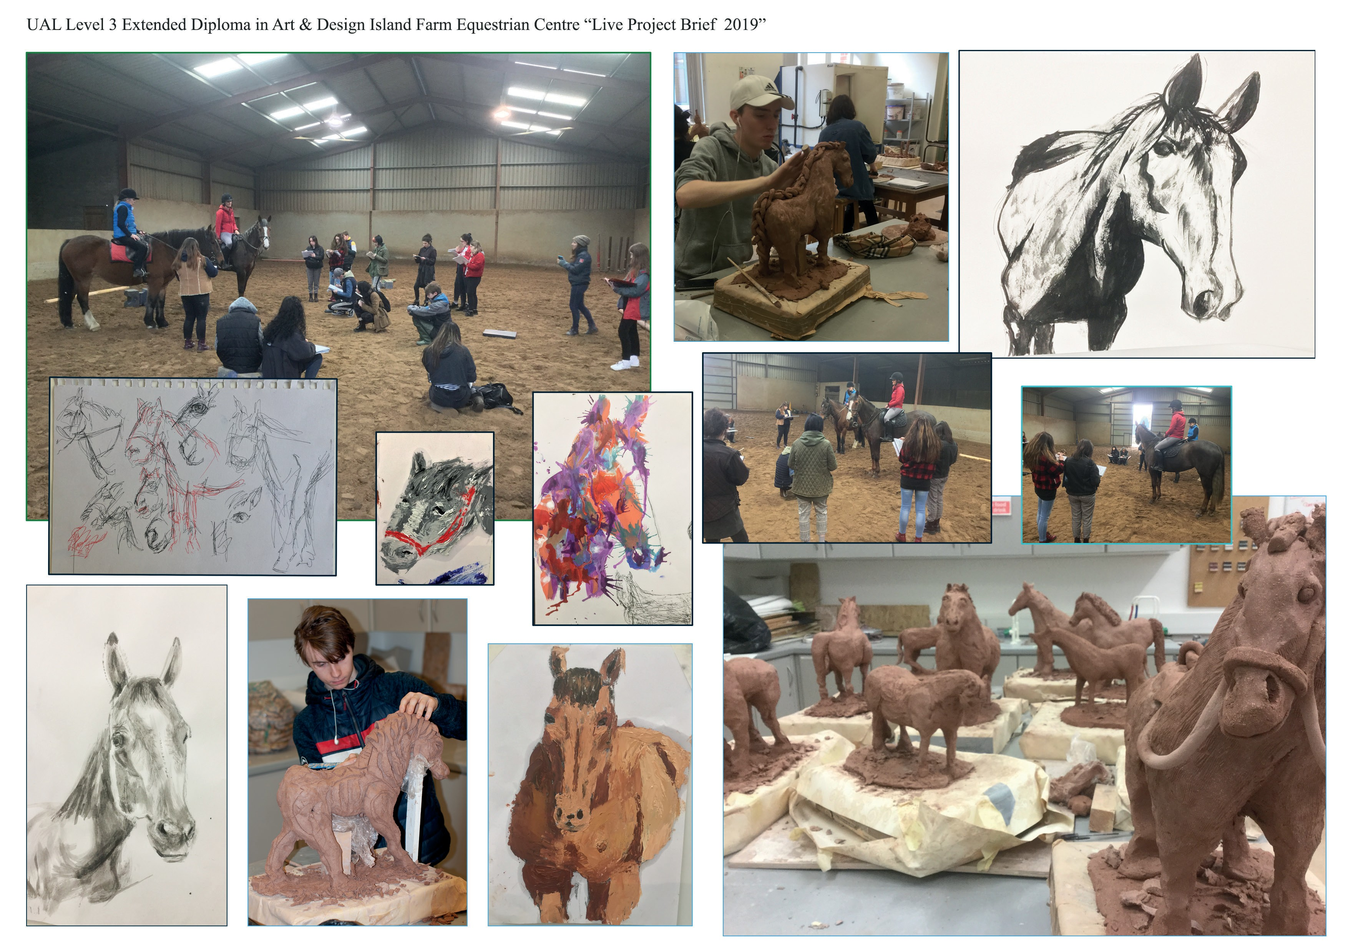
Art and Design
UAL Level 3 Diploma / Extended Diploma
www.nwrc.ac.uk

Slide 6



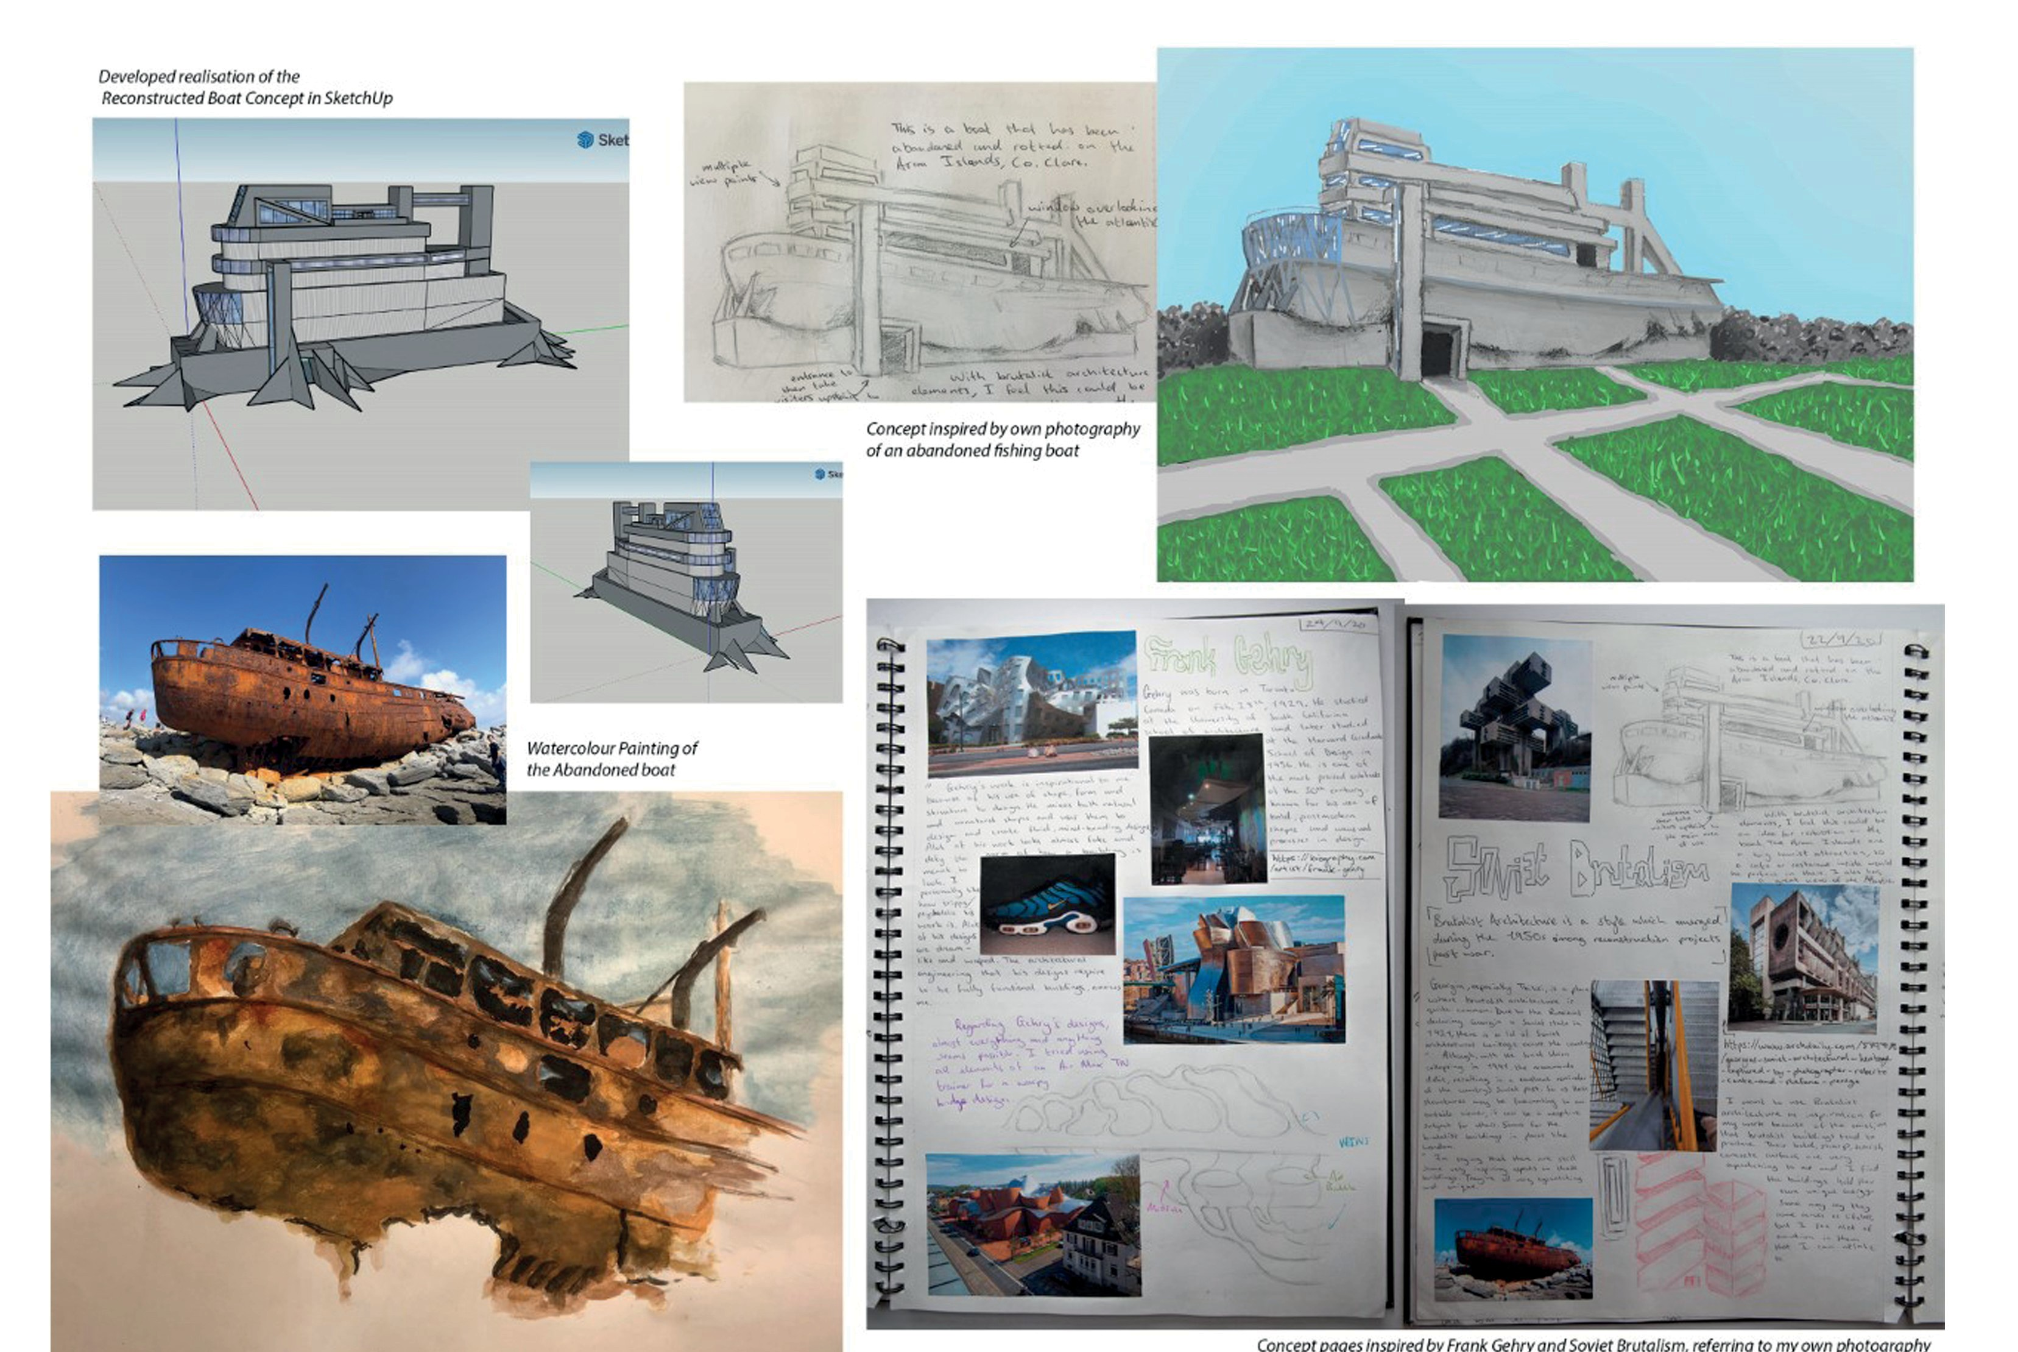
Art and Design
UAL Level 3 Diploma / Extended Diploma
www.nwrc.ac.uk

Slide 7



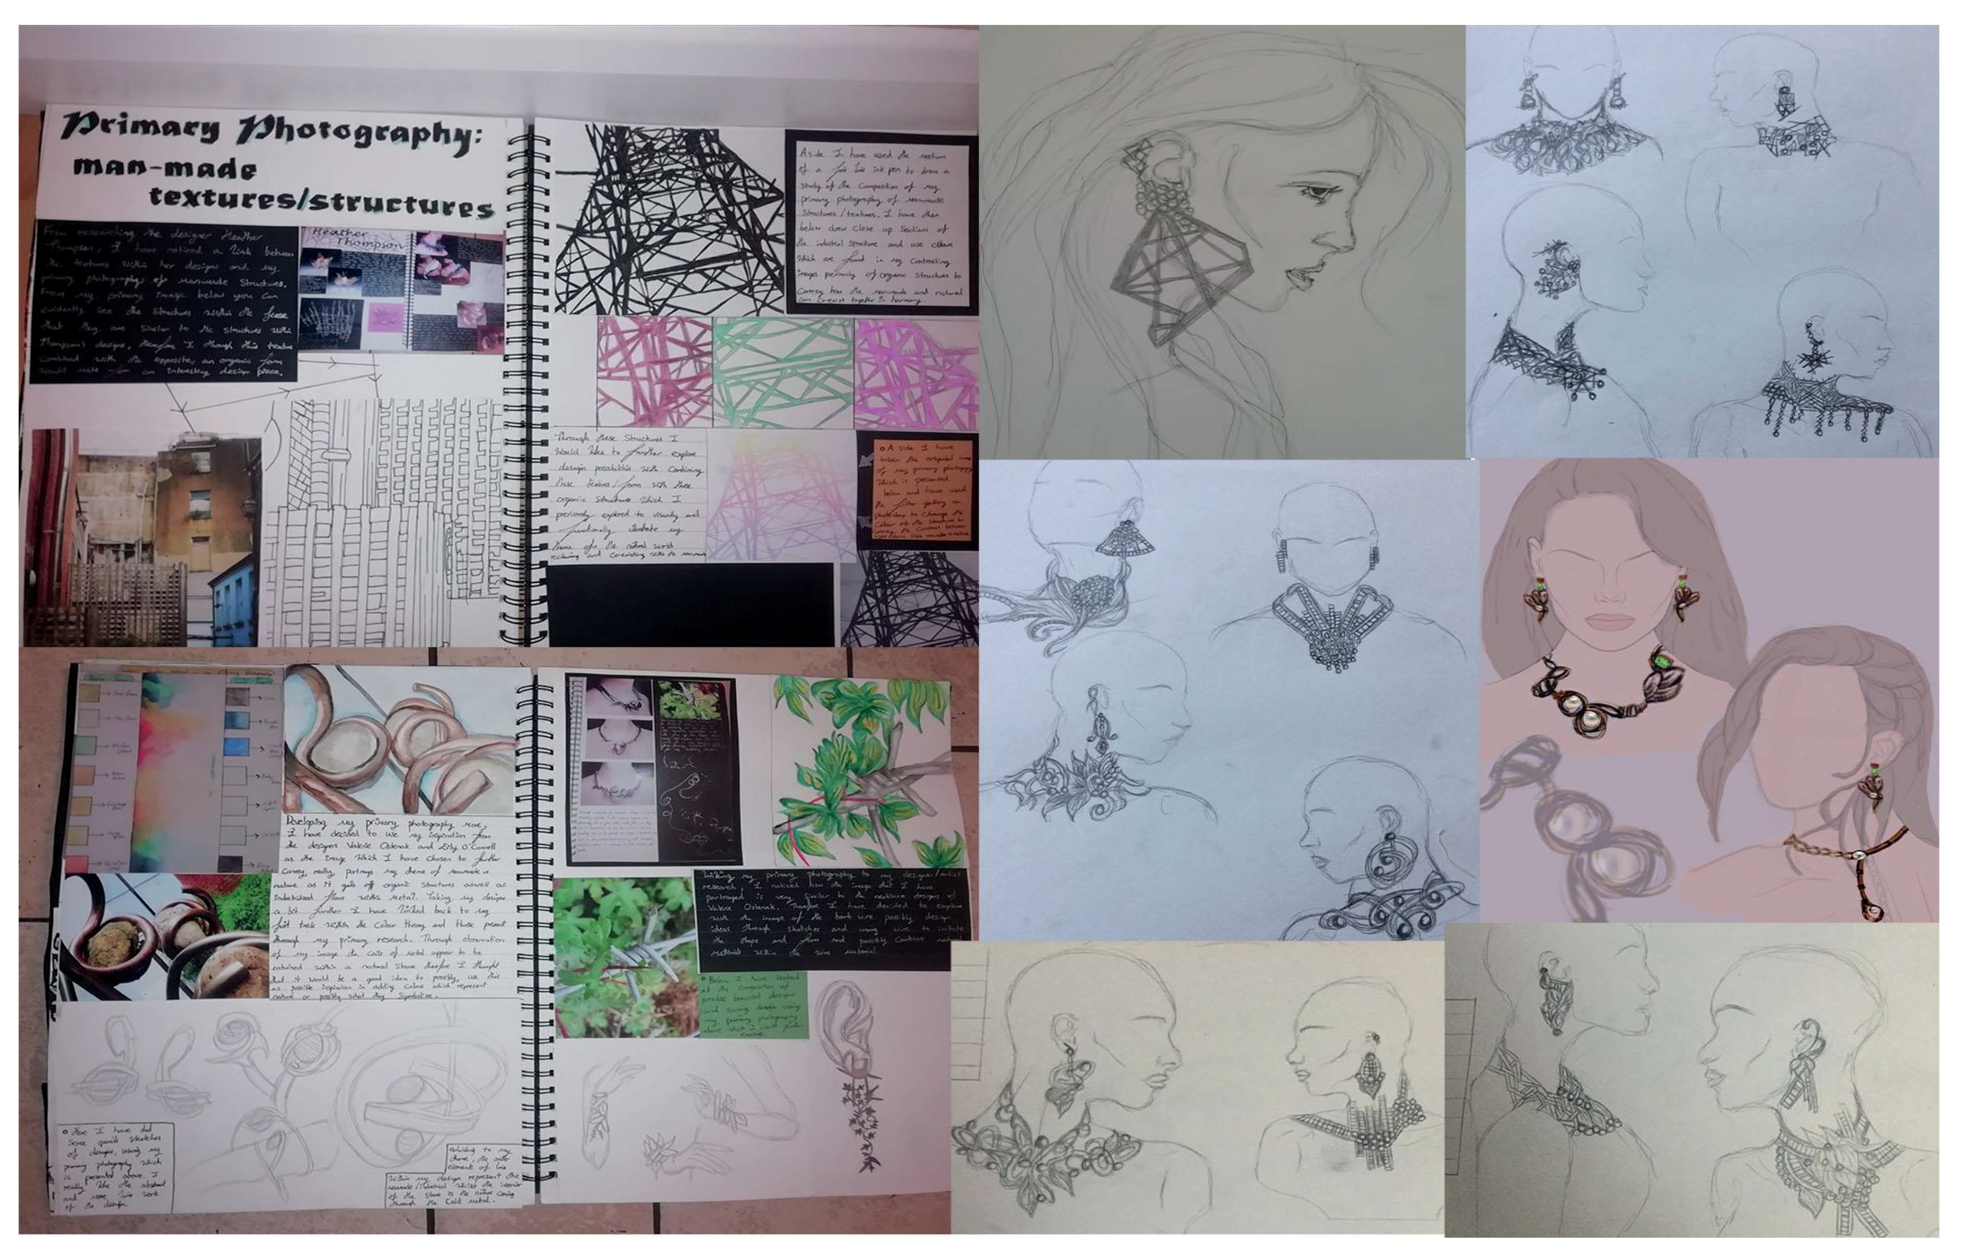
Art and Design
UAL Level 3 Diploma / Extended Diploma
www.nwrc.ac.uk

Slide 8
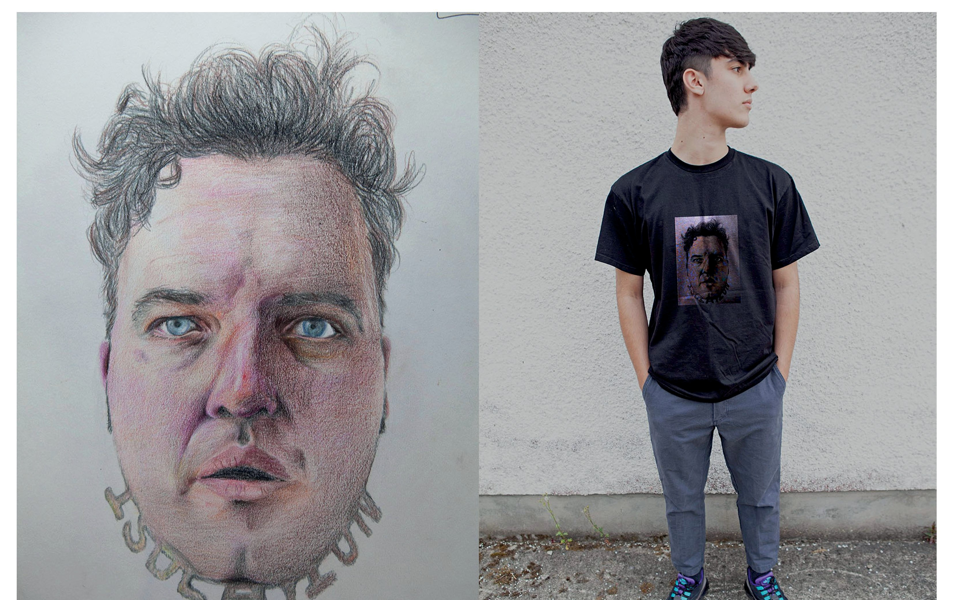
Art and Design
UAL Level 3 Diploma / Extended Diploma
www.nwrc.ac.uk

Slide 9
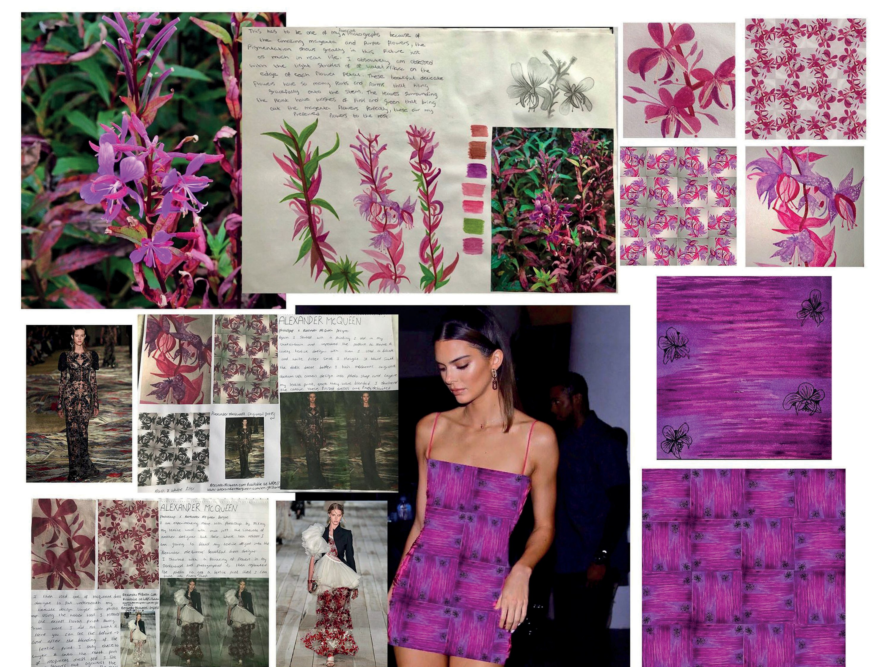
Art and Design
UAL Level 3 Diploma / Extended Diploma
www.nwrc.ac.uk

Slide 10



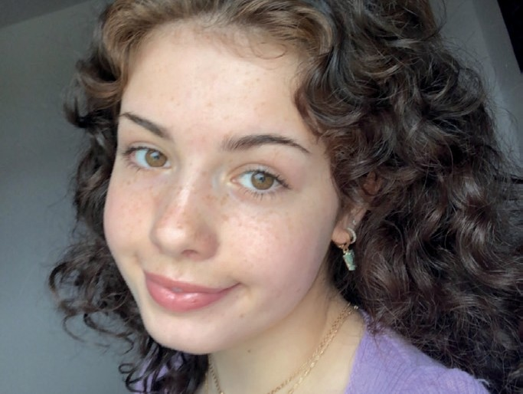

UAL Level 3 Diploma / Extended Diploma
Art and Design
My time at NWRC has been amazing, I have made great friends and thoroughly enjoyed my course studying the extended diploma in art and design. During these past two years, I have had the c-reative freedom to explore the possibilities for
my future. I am now ready to advance onto university level with the incredible
guidance and support I have received from my tutors who have always pushed me to the best of my ability. The atmosphere at this college is something I will miss.
Emer Delvin
While studying on a level 3 art and design course, I have been given wonderful support and inspiration by all the faculty staff to progress and realise my goal in studying design at a University level. Even during these challenging times, I have learnt a lot and have continuously been motivated by both my tutors and peers
Natalie McDaid
www.nwrc.ac.uk
#ApplyNow

Slide 11



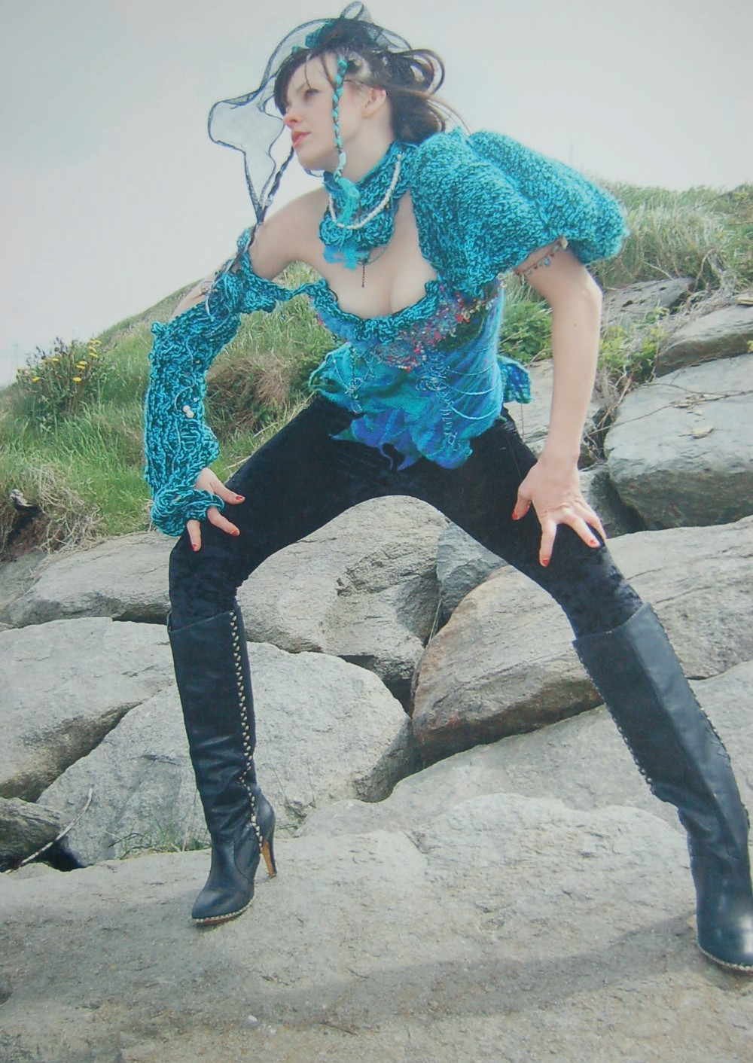
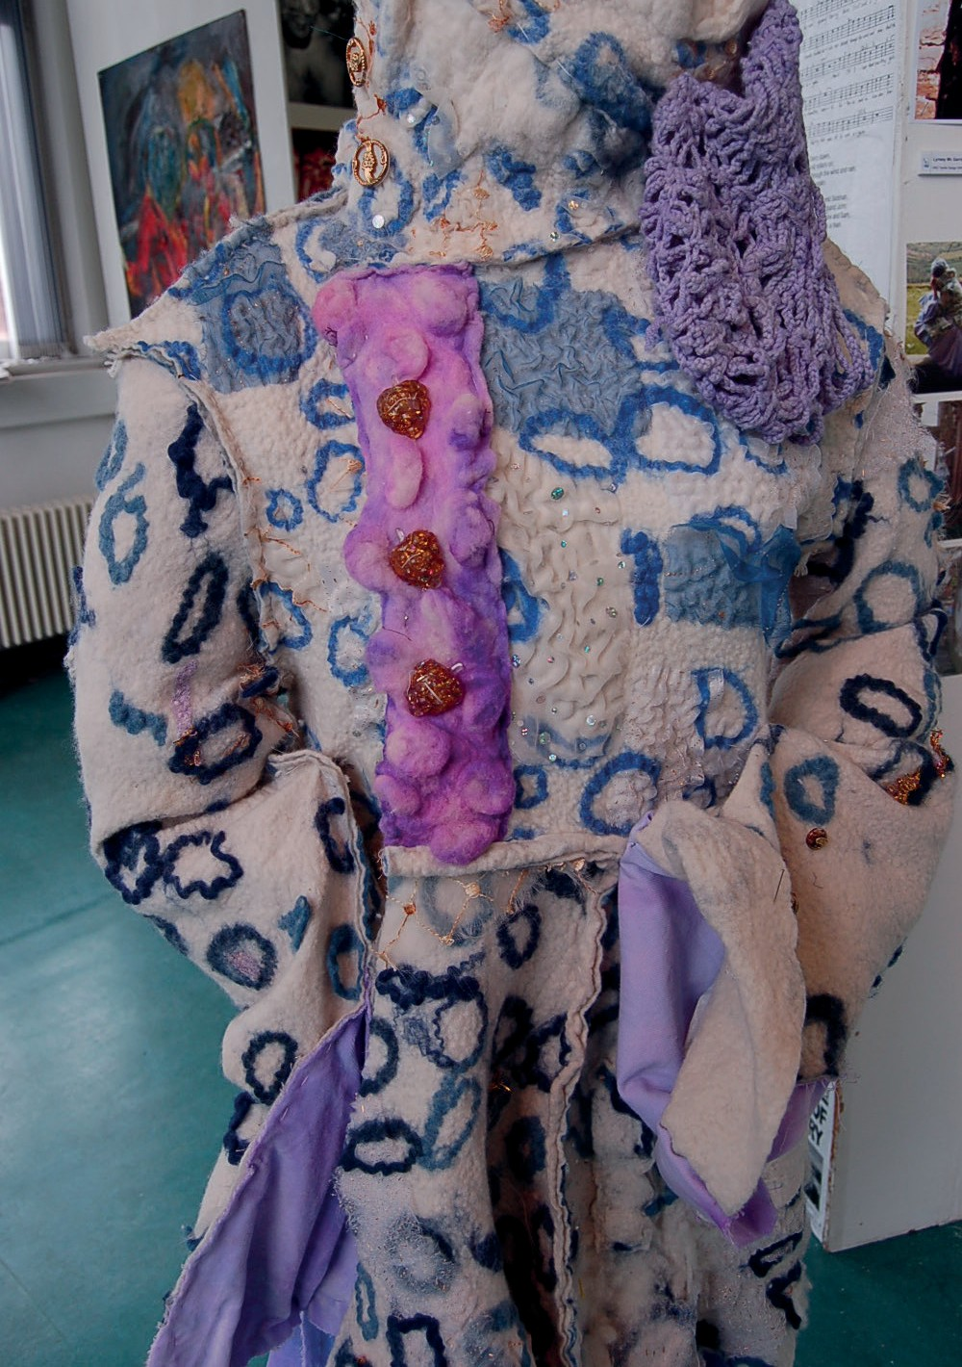
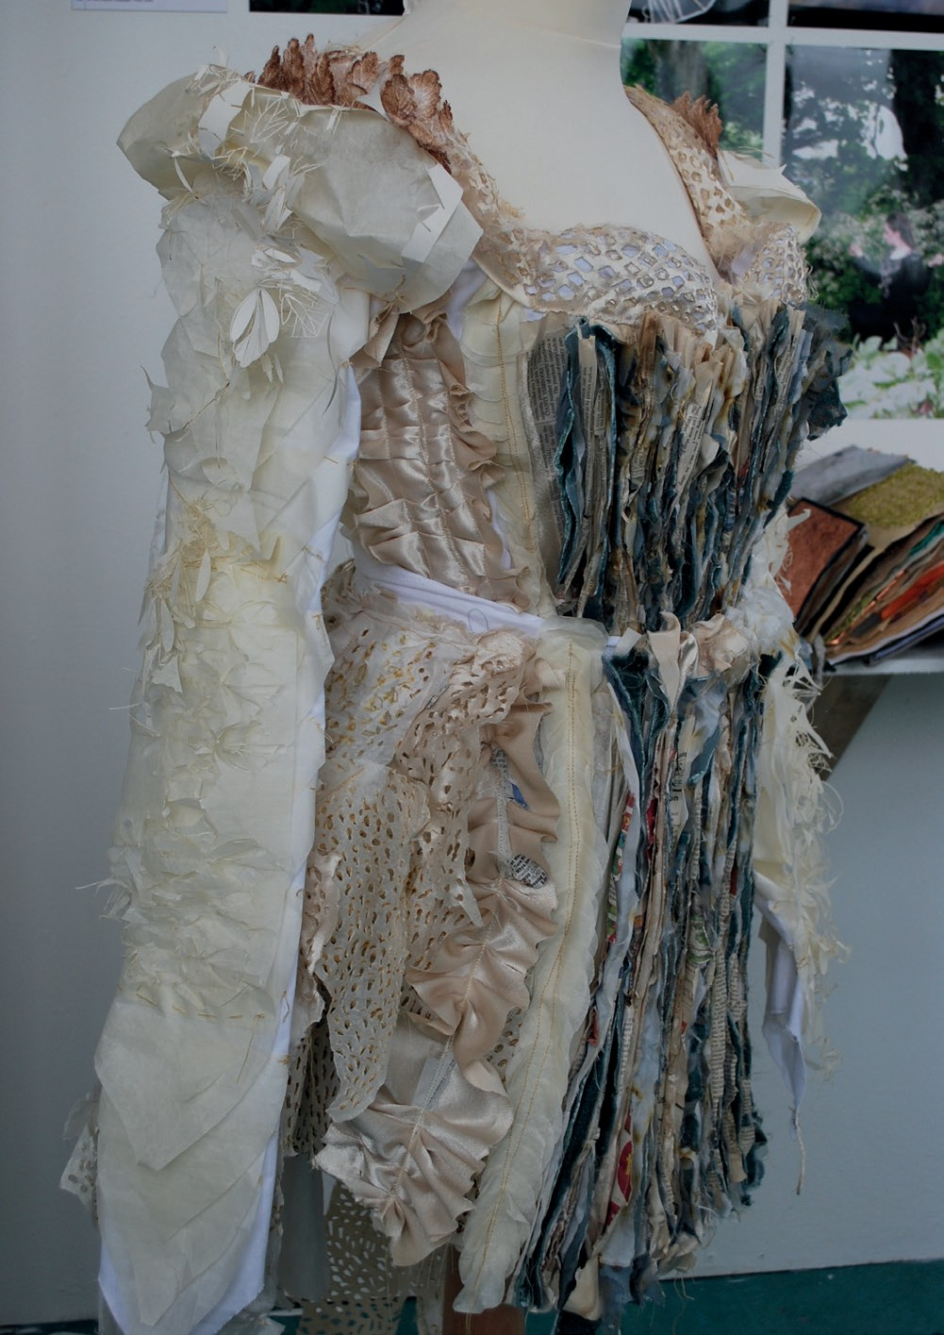
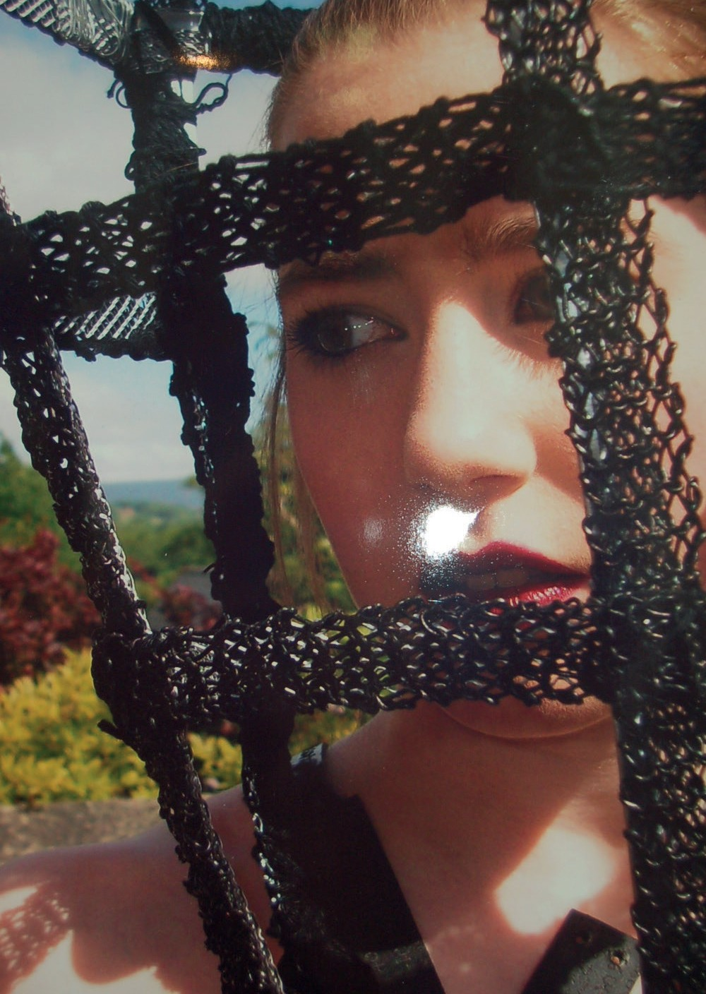






Art and Design
UAL Level 3 Foundation Diploma
www.nwrc.ac.uk
#ApplyNow

Slide 12



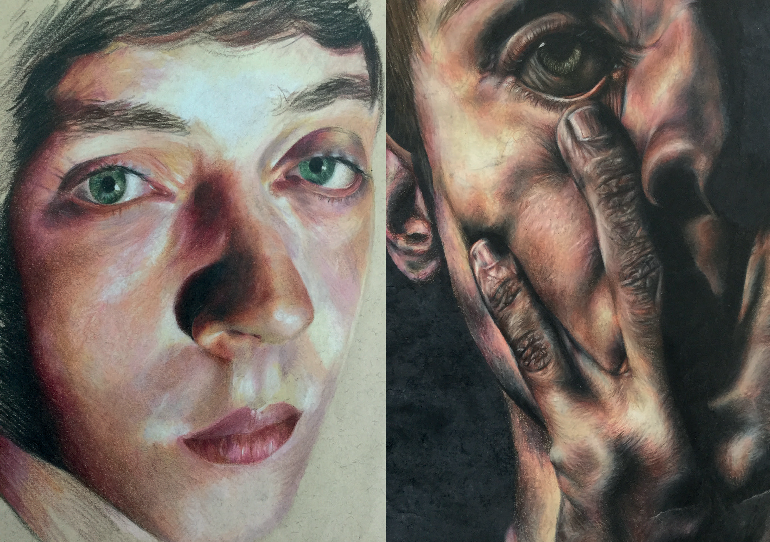
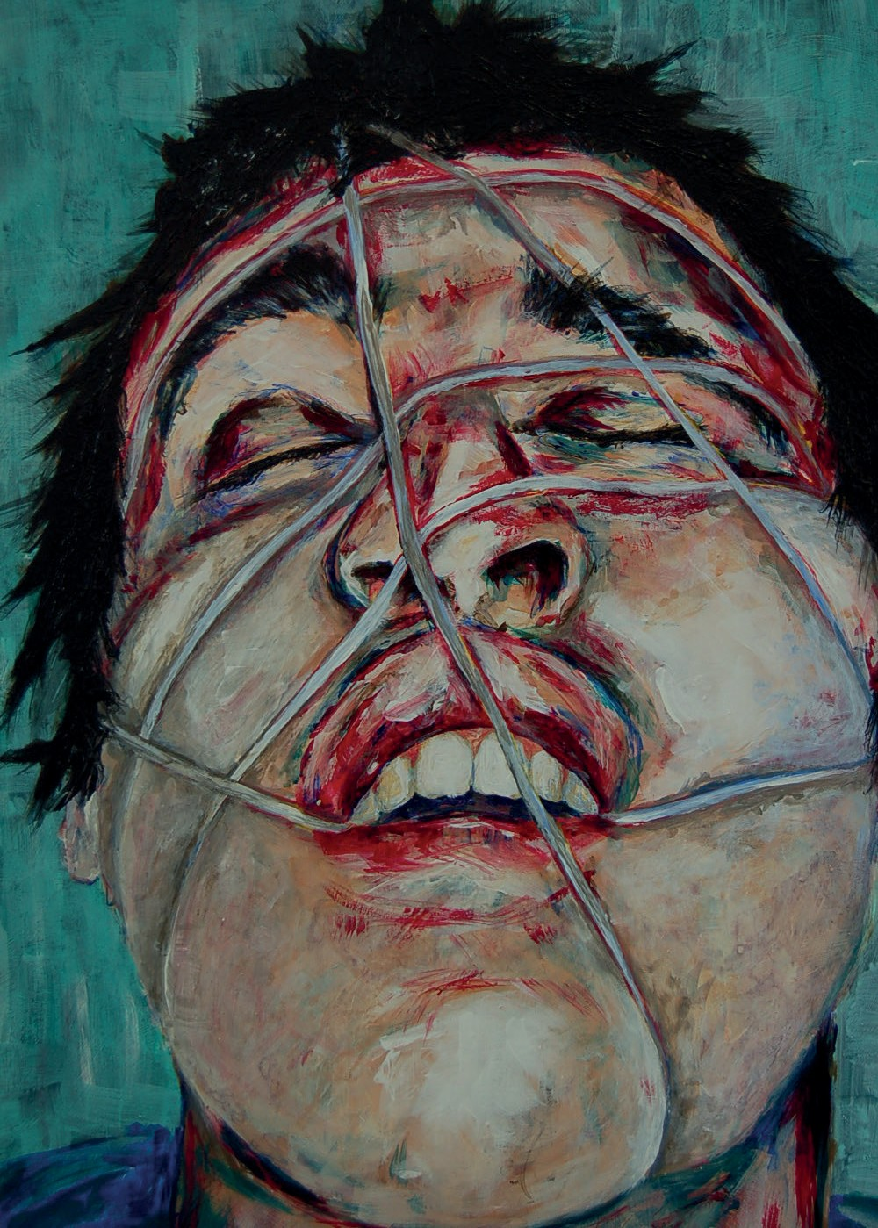
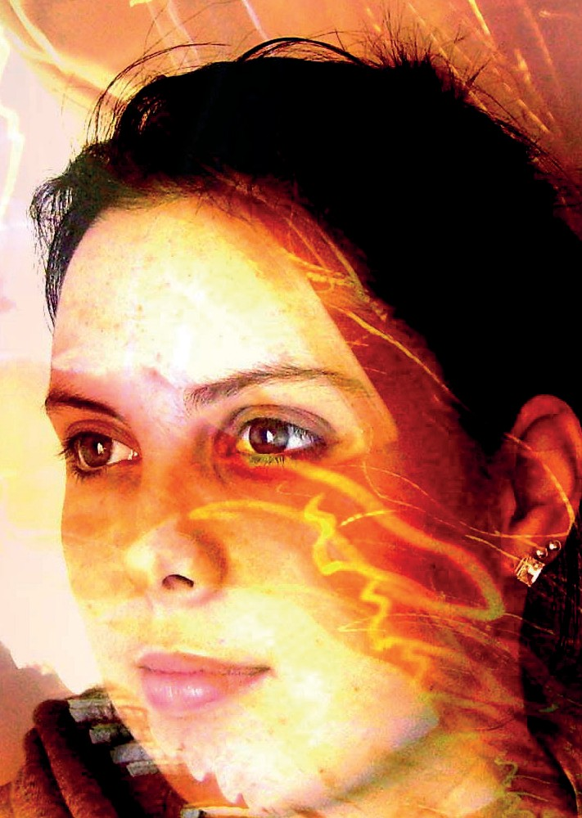






Art and Design
UAL Level 3 Foundation Diploma
www.nwrc.ac.uk
#ApplyNow

Slide 13
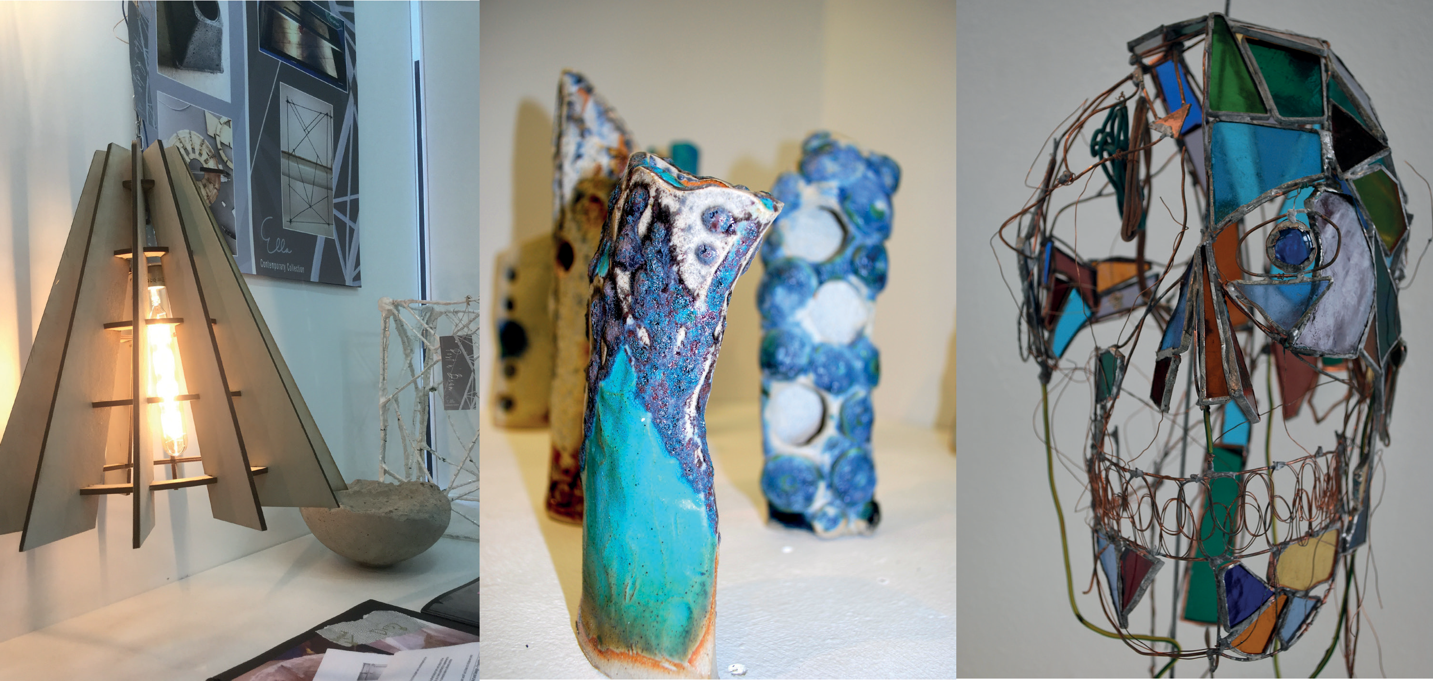
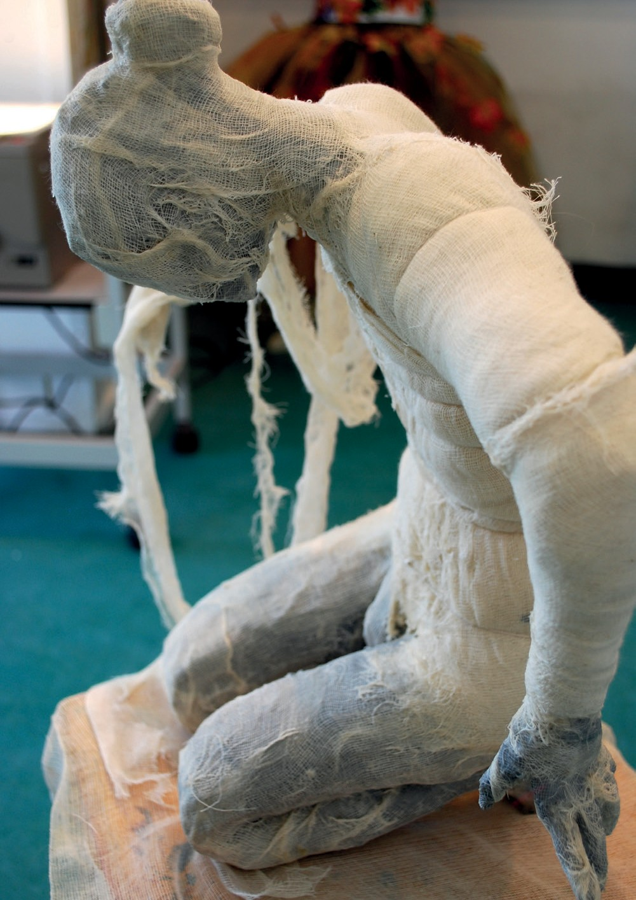

Art and Design
UAL Level 3 Foundation Diploma
www.nwrc.ac.uk
#ApplyNow

Slide 14
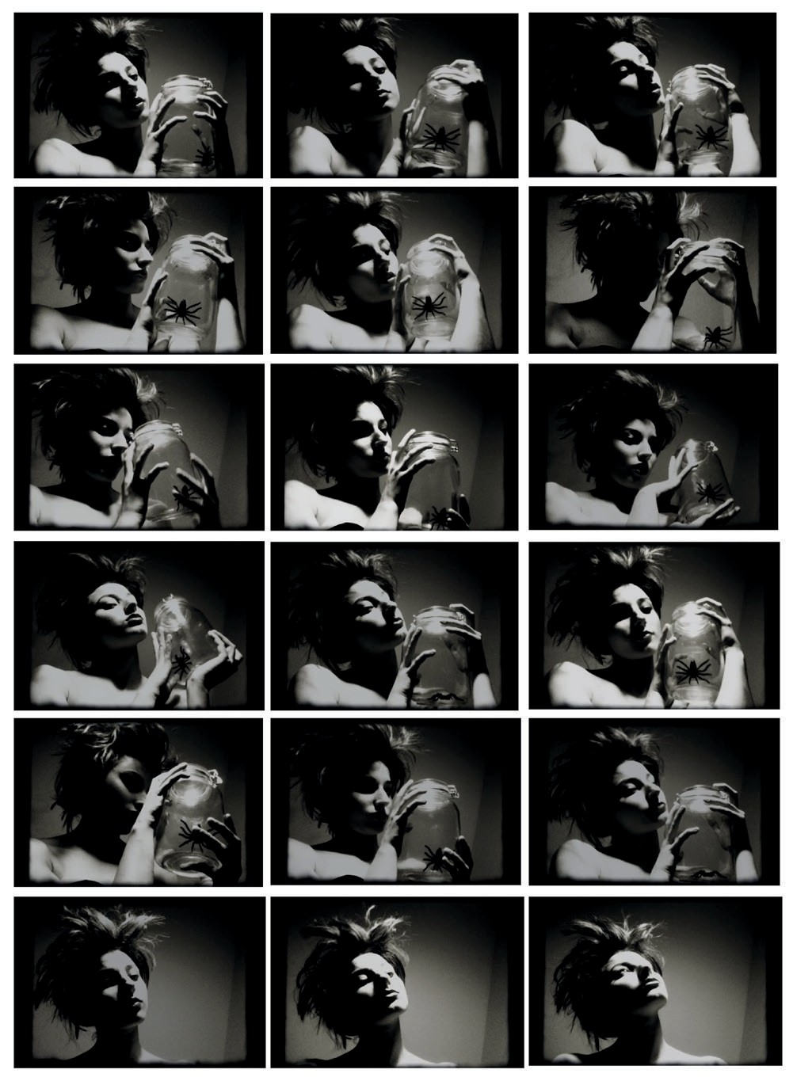


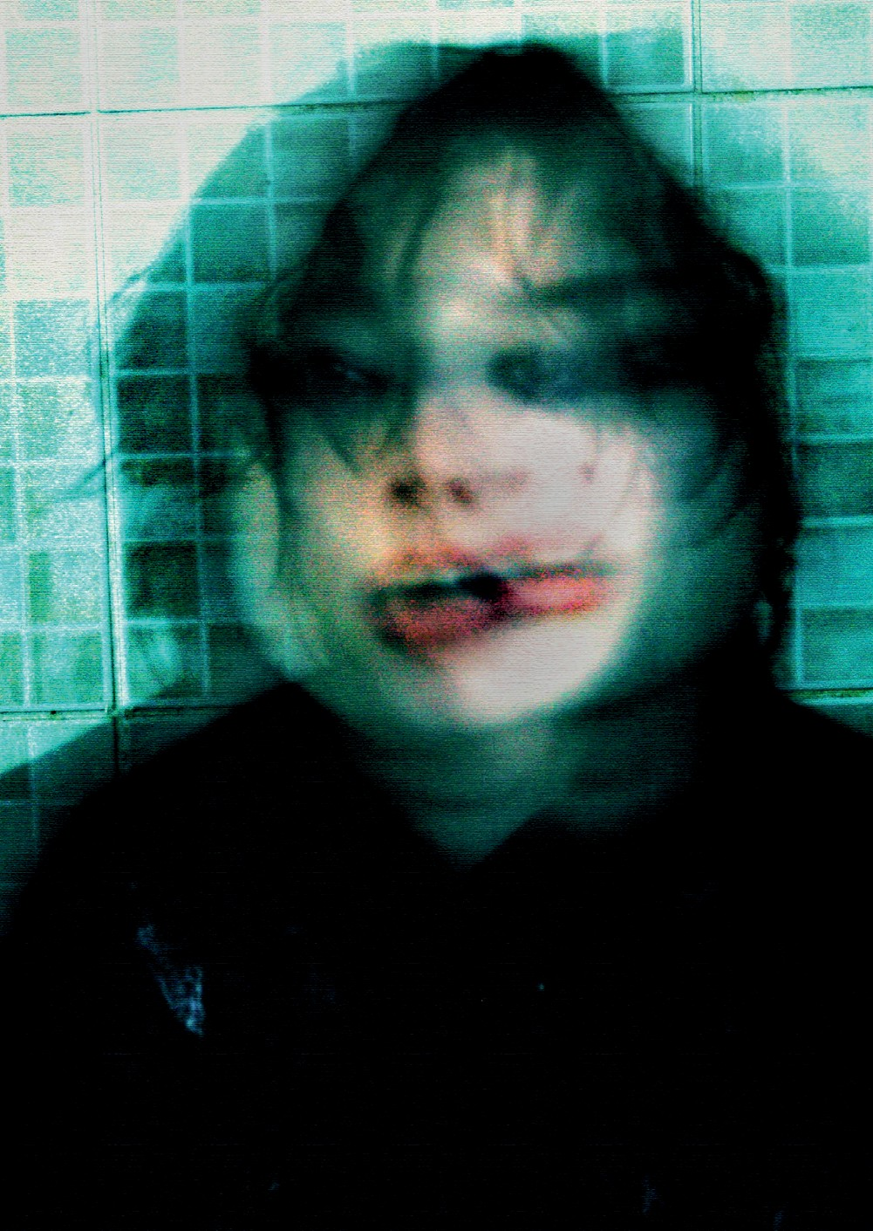





Art and Design
UAL Level 3 Foundation Diploma
www.nwrc.ac.uk
#ApplyNow

Slide 15



UAL Level 3 Foundation Diploma
Art and Design
Even through the pandemic the course was thoroughly enjoyable, and I met so many new friends and lovely people. The course was an amazing step towards my career as an artist and I would highly recommend doing this.
Orla Jackson
Despite current lockdown restrictions the course has been very enjoyable and informative. I’ve learnt a lot and feel I’ve developed as an artist
Ciara Harkin
www.nwrc.ac.uk
#ApplyNow

Slide 16





UAL Level 3 Foundation Diploma
Art and Design
Despite covid and working from home being in this course kept me motivated, provided me with independent skills and I really enjoyed this past year
This course is a great opportunity for you to try out new skills and develop yourself as an artist
Colleen Mc Sheffrey
Eleanor Duffy
www.nwrc.ac.uk
#ApplyNow

Slide 17


UAL Level 3 Foundation Diploma
Art and Design
This course has really got me out of my comfort zone and showed me what I’m capable of, even with lockdown restrictions.
Norah Anne Clarke
Thoroughly enjoying the various projects and being able to develop my art skills in a free, creative environment
Annie Brown
www.nwrc.ac.uk
#ApplyNow

Slide 18
UAL Level 3 Foundation Diploma
Art and Design
Perfect opportunity for students to cultivate their artistic expression by experimenting with a range of artistic practices, in a freedom-oriented learning environment.
Katelyn Brolly
As a mature student I was very nervous going back to studies. However, Kathleen, Gerard & Jeanie have encouraged me throughout the year to keep going despite many obstacles I have enjoyed this course immensely.
Orla Murphy
www.nwrc.ac.uk
#ApplyNow

Slide 19






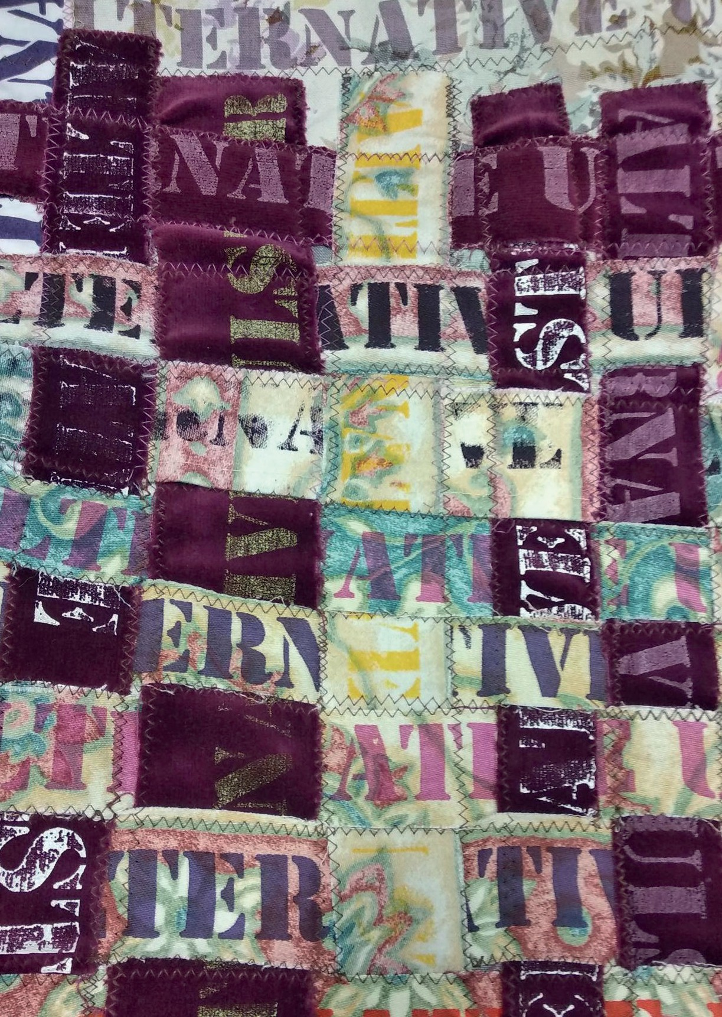
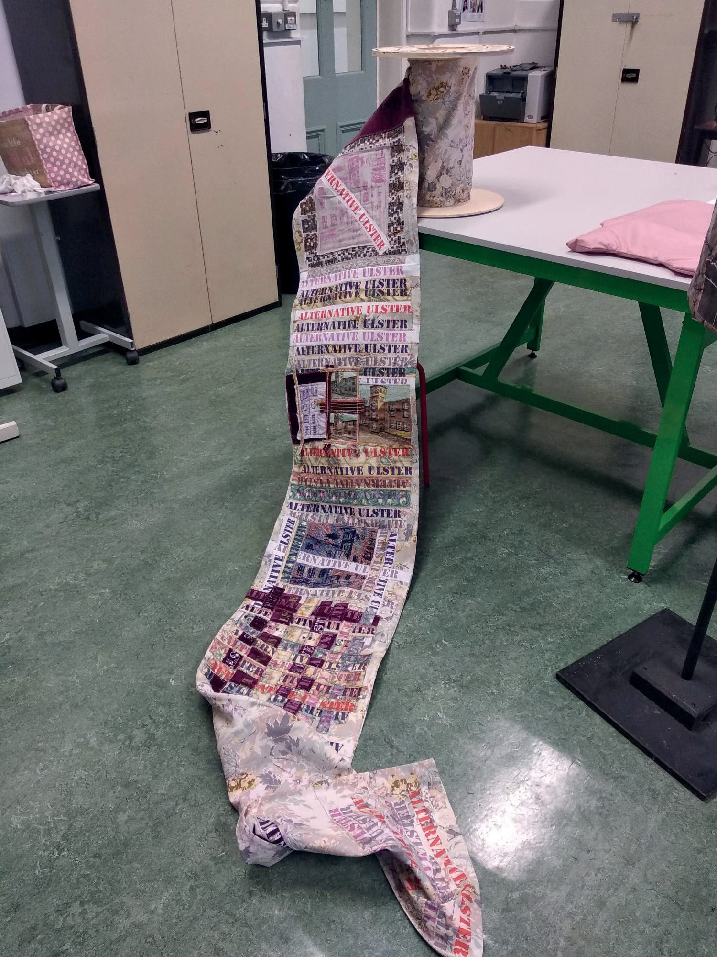
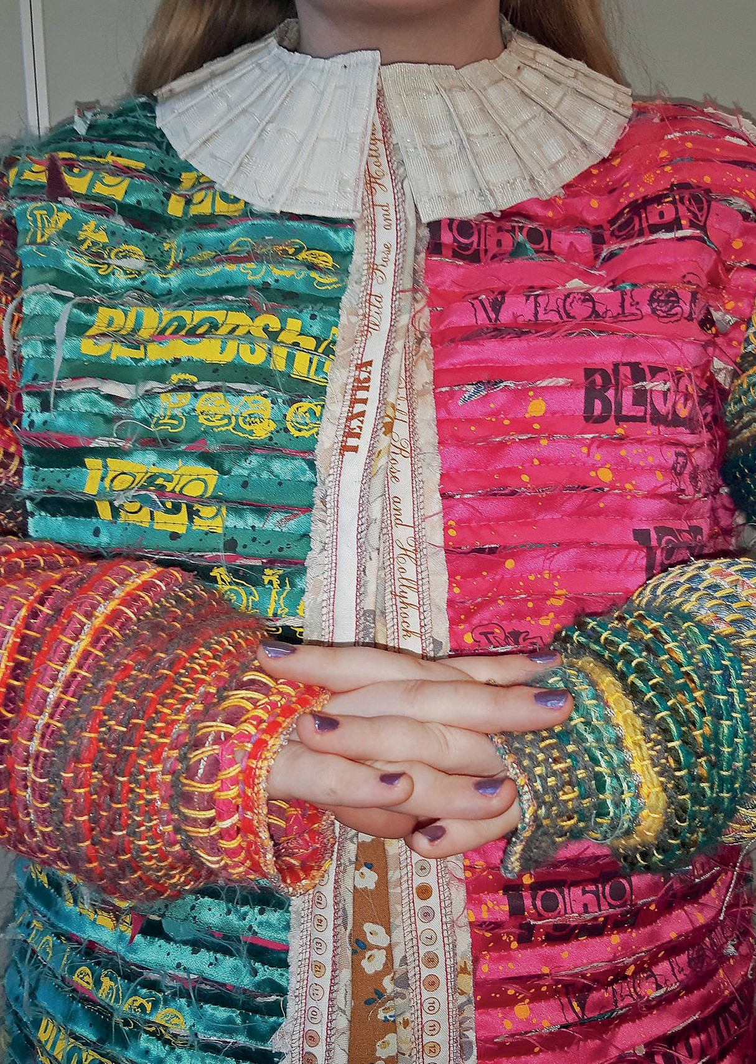
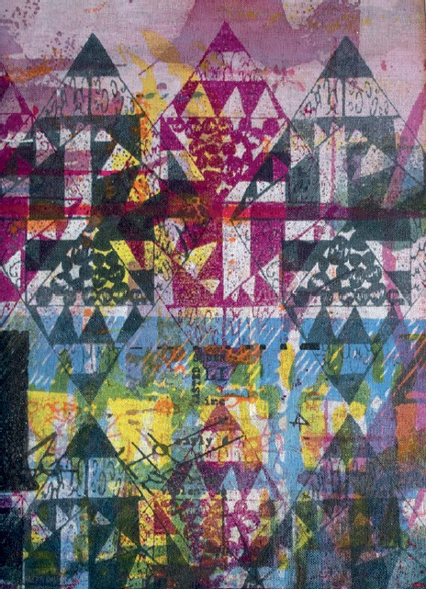



Art and Design (Textiles)
BTEC Level 5 Higher National Diploma
www.nwrc.ac.uk
#ApplyNow

Slide 20







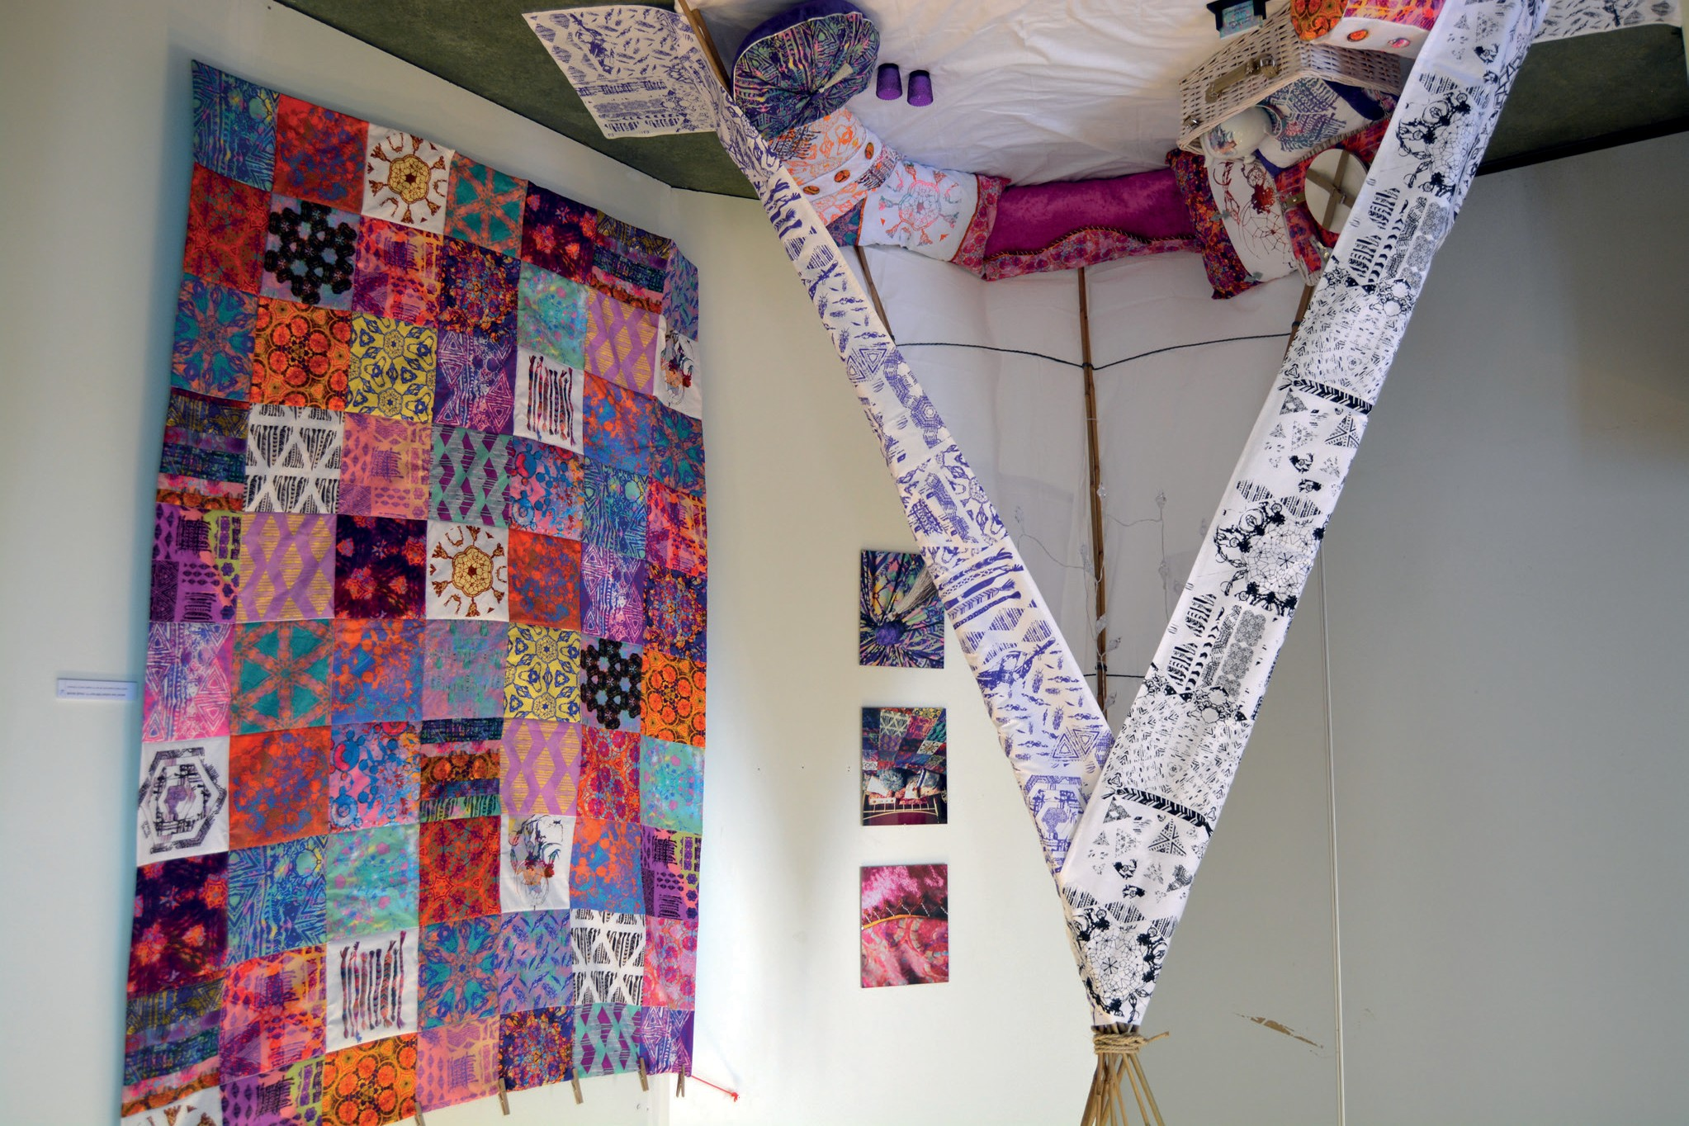






Art and Design (Textiles)
BTEC Level 5 Higher National Diploma
www.nwrc.ac.uk
#ApplyNow

Slide 21

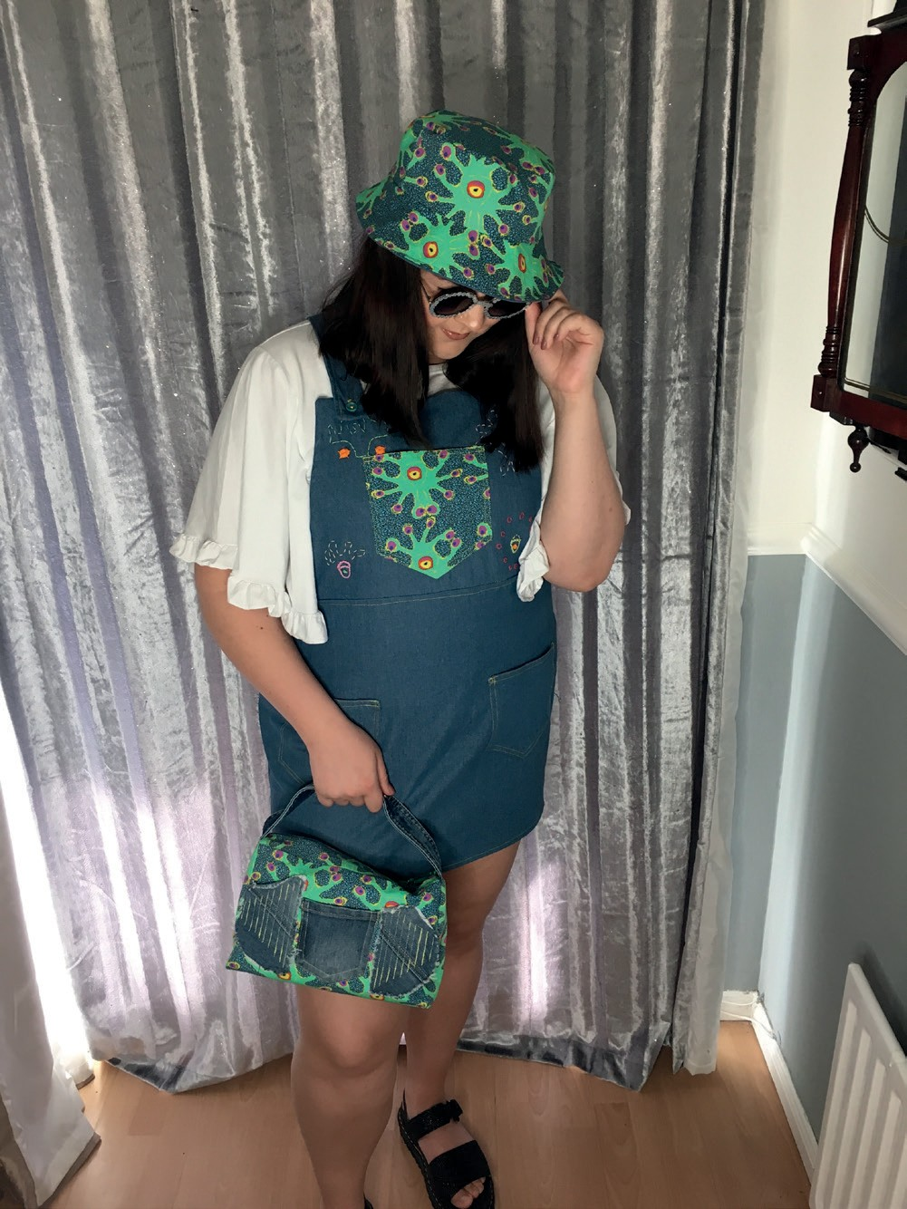
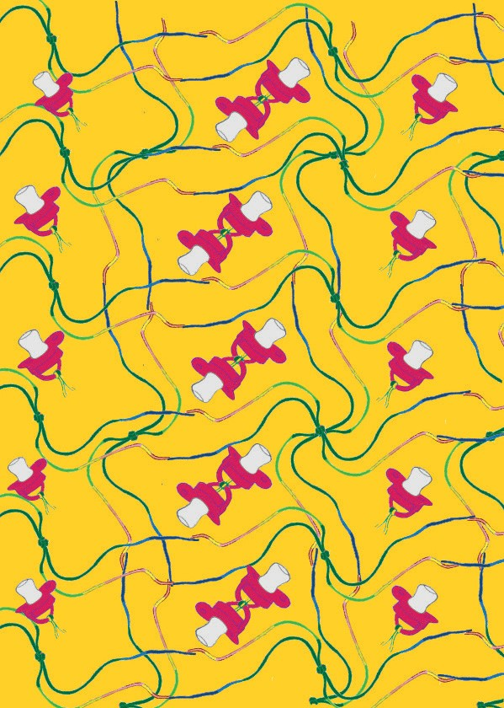
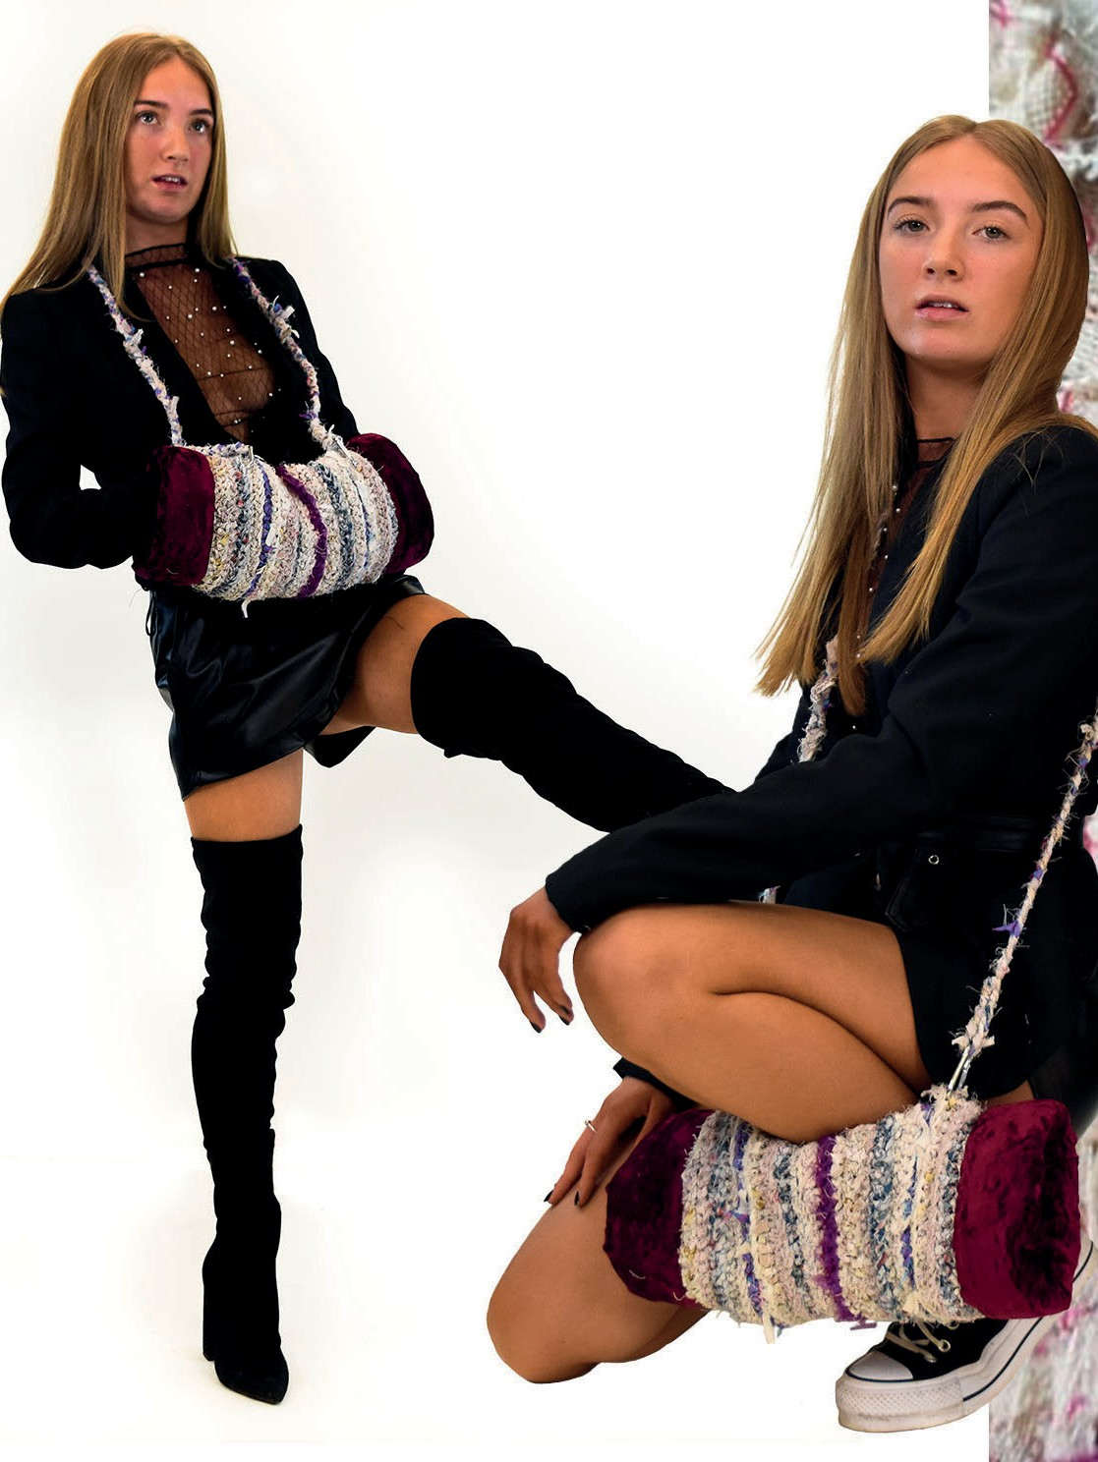
Art and Design (Textiles)
BTEC Level 5 Higher National Diploma
www.nwrc.ac.uk
#ApplyNow

Slide 22

BTEC Level 5 Higher National Diploma
Art and Design (Textiles)
“Attending the Fashion and Textile HND course was the best decision that I ever made. The skills that I gained and the facilities that I used prepared me to progress onto University and successfully graduate. The HND course taught me skills for textiles, I met new friends and with the support of staff I gained a lot of confidence with my work and myself. I would highly recommend this course and college to anyone who has an interest in fashion or textiles.”
Nicole McLaughlin
(Post Graduate, HND Textile Design)
“I really enjoyed the HND course for Textile Design. It helped me learn and refine a variety of different design skills, which have helped motivate me and prepare me for university and to decide exactly what kind of designer I want to be.
Rebecca Cregan
(Post Graduate, HND Textile Design)
www.nwrc.ac.uk
#ApplyNow

Slide 23




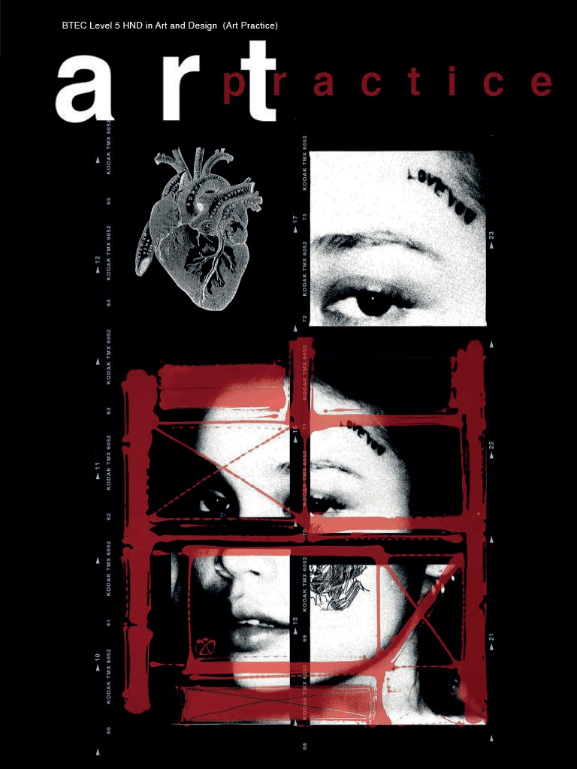
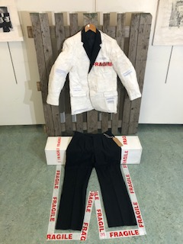
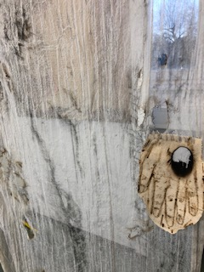
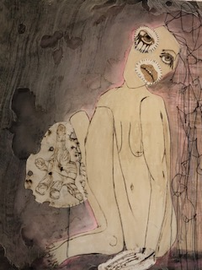
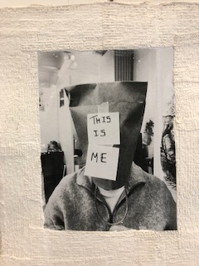
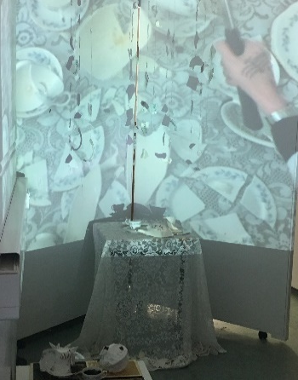
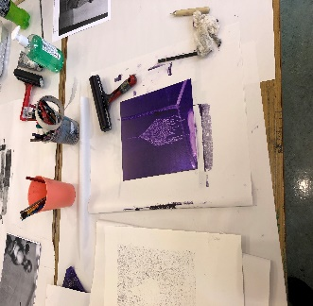
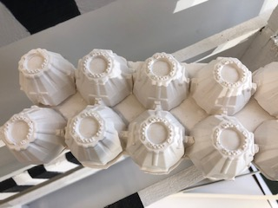
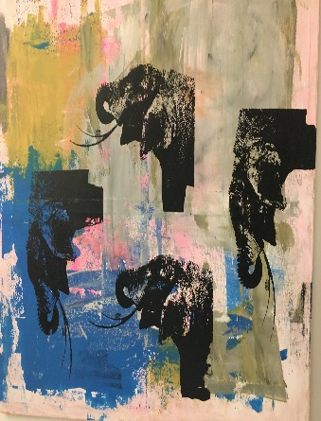
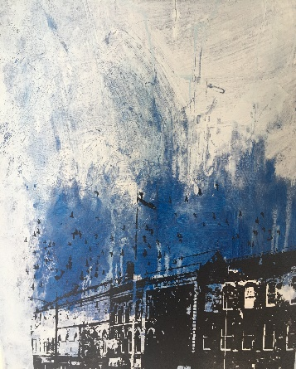
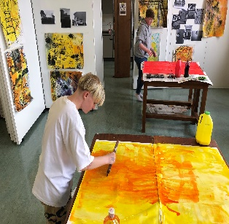
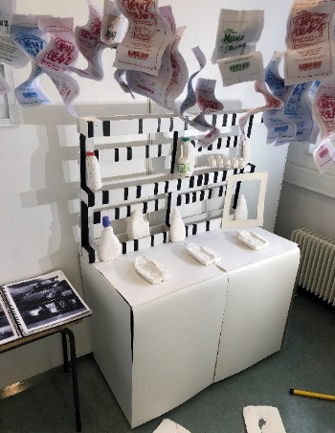
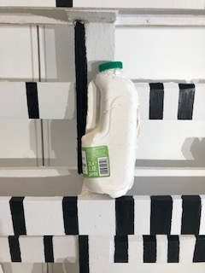
Art and Design (Art Practice)
BTEC Level 5 Higher National Diploma
www.nwrc.ac.uk
#ApplyNow

Slide 24
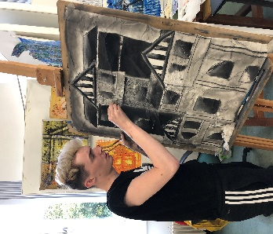
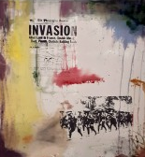
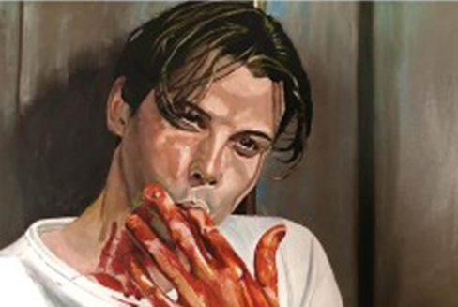
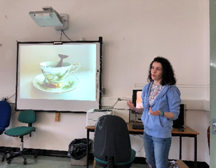
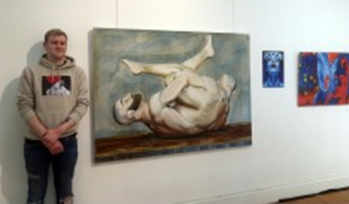
Art and Design (Art Practice)
BTEC Level 5 Higher National Diploma
www.nwrc.ac.uk
#ApplyNow

Slide 25
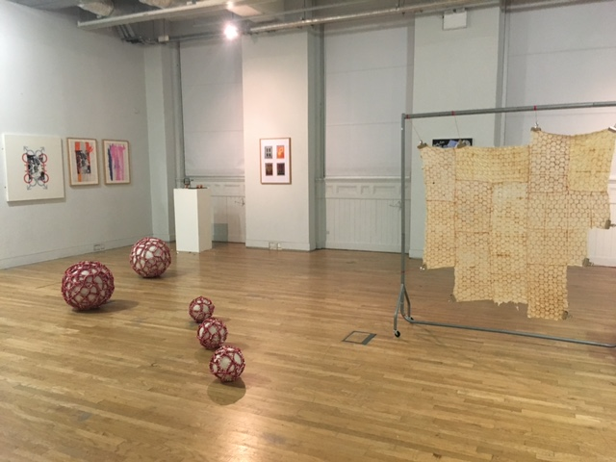
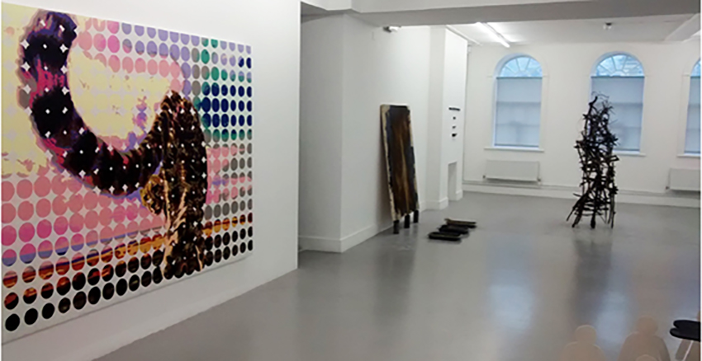
Art and Design (Art Practice)
BTEC Level 5 Higher National Diploma
HND Art Practice at NWRC provides a route to both 2nd and 3rd year Fine Art Courses in Ireland and Britain and a springboard to the diverse and expanding world of contemporary art practices
www.nwrc.ac.uk
#ApplyNow

Slide 26




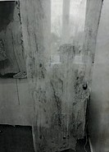

BTEC Level 5 Higher National Diploma
Art and Design (Art Practice)
‘The HND ART Practice course has prepared me to successfully
apply and select the correct Degree pathway for a future career within The Creative Industries. It has enabled me to meet amazing people that share similar interests.’
The HND Art Practice course at NWRC has been an excellent experience for me, I have grown in confidence. The support and
guidance from my tutors have been phenomenal, even though the pandemic restrictions.
www.nwrc.ac.uk
#ApplyNow

Slide 27








BTEC Level 5 Higher National Diploma
Art and Design (Art Practice)
As I arrived at my first art class at NWRC I wondered if I had made the right decision. This would be my first art class in decades, and when I did have a class, I didn’t do very well. After a few minutes I had forgotten my doubts as I was too busy enjoying our first activity, and that sense of enjoyment continued throughout the courses I took at the college.
opportunity to learn about artists from the past and those working at the moment, and to study their work, and always the question of what influence they might have on my own ideas. By the end of the Foundation course I felt I had learned a lot, and also conscious that there was a lot more to discover.
The journey continued! HND followed, with the chance to be more independent . The facilities of the college were at our disposal and the only limitation was our imagination and knowledge. There were still new things to discover- video and sound, painting and drawing on a large scale, the opportunity to
put on an exhibition in a proper art gallery, and to research and write about artists and the art we made ourselves. As before, staff guided and encouraged us, and class members shared experience and skills in an informal way.
My next course with NWRC brought me to Limavady and the HNC Course. This gave me the opportunity to consolidate skills, and presented new opportunities. Early on in the course we were introduced to the magic of print, where ink and paper were brought together in such a way that transformation happened. In addition to print, there was sculpture too—paper, sugar cubes (!) and clay could be folded and moulded and coloured and glazed to produce shapes and structures, which could add new dimensions to painting and drawing,
as well as be art works in their own right. The course passed quickly, was very enjoyable, an opened up new areas of learning and exploration.
The Foundation coursed gave me the opportunity to try out and experiment with many techniques that were completely new to me. Drawing with pencil soon became drawing with wire, and each class brought something new. After a while we were able to build on new skills, and simple materials were used to create pictures and images which I had no idea I could create. The tutors were knowledgeable and encouraging, there was time for questions
and very often answers suggested new ideas to experiment with. Fellow students were also an important source of information and encouragement. In addition to studio time there was also the
I have continued the journey of discovery to study Fine Art at IT Sligo. The skills I learnt and the experience I gained at NWRC have prepared me to engage in this new course and continue the journey of art, and to enjoy the challenges and rewards it brings.
www.nwrc.ac.uk
#ApplyNow

Slide 28






UAL Level 3 Diploma / Extended Diploma
Art and Design
Course Contact:
Ursula Coyle 02871276579 ursula.coyle@nwrc.ac.uk
Course Contact:
Kathleen Doherty 028 7127 6156 kathleen.doherty@nwrc.ac.uk
Gerard Maxwell 02871276583
gerard.maxwell@nwrc.ac.uk
UAL Level 3 Foundation Diploma
Art and Design
BTEC Level 5 Higher National Diploma
Art and Design (Textiles)
Course Contact:
Mary Harrigan 028 7127 6584 mary.harrigan@nwrc.ac.uk
BTEC Level 5 Higher National Diploma
Art and Design (Art Practice)
Course Contact:
Anne Bryce 02871276083
anne.Bryce@nwrc.ac.uk
Conor McFeely 028 7127 6582 conor.mcfeely@nwrc.ac.uk
www.nwrc.ac.uk
#ApplyNow

